Slide 1
Coupling

Slide 2
Module Coupling
In software engineering, the coupling is the degree of interdependence between software modules.
Two modules that are tightly coupled are strongly dependent on each other.
However, two modules that are loosely coupled are not dependent on each other.
Uncoupled modules have no interdependence at all within them.

Slide 3
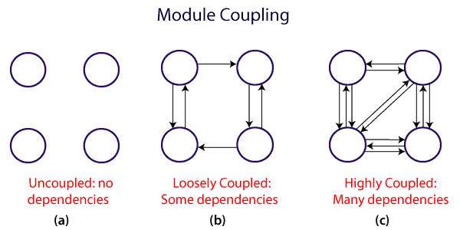

Slide 4
A good design is the one that has low coupling.
Coupling is measured by the number of relations between the modules.
That is, the coupling increases as the number of calls between modules increase or the amount of shared data is large.
Thus, it can be said that a design with high coupling will have more errors.

Slide 5
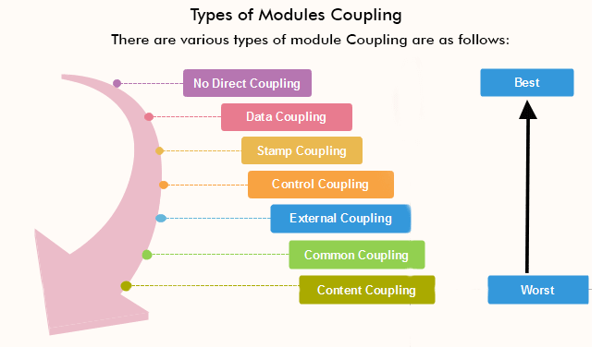
Types of Module Coupling

Slide 6
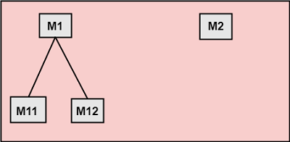
No Direct Coupling
There is no direct coupling between M1 and M2.
In this case, modules are subordinates to different modules.
Therefore, no direct coupling.

Slide 7
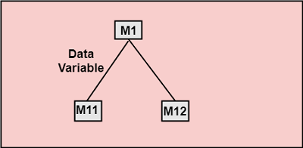
Data Coupling
When data of one module is passed to another module, this is called data coupling.

Slide 8
Stamp Coupling
Two modules are stamp coupled if they communicate using composite data items such as structure, objects, etc.
When the module passes non-global data structure or entire structure to another module, they are said to be stamp coupled.
For example, passing structure variable in C or object in C++ language to a module.

Slide 9
Control Coupling
Control Coupling exists among two modules if data from one module is used to direct the structure of instruction execution in another.

Slide 10
External Coupling
External Coupling arises when two modules share an externally imposed data format, communication protocols, or device interface.
This is related to communication to external tools and devices.

Slide 11
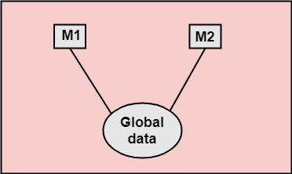
Common Coupling
Two modules are common coupled if they share information through some global data items.

Slide 12
Content Coupling
Content Coupling exists among two modules if they share code, e.g., a branch from one module into another module.

Slide 13
Cohesion

Slide 14
Modular cohesion
In computer programming, cohesion defines to the degree to which the elements of a module belong together.
Thus, cohesion measures the strength of relationships between pieces of functionality within a given module.
For example, in highly cohesive systems, functionality is strongly related.
Cohesion is an ordinal type of measurement and is generally described as "high cohesion" or "low cohesion."

Slide 15
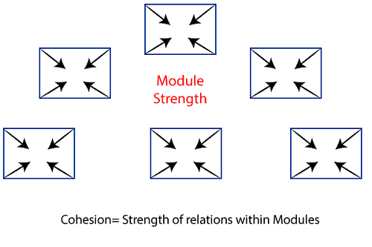

Slide 16
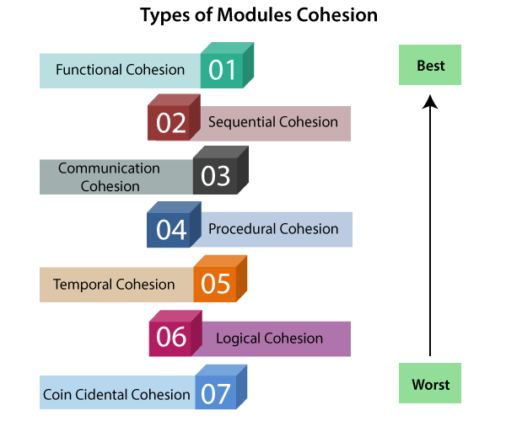
Types of Modules Cohesion

Slide 17
Functional Cohesion
All elements contribute to the execution of one and only one problem-related task
Focussed - strong, single-minded purpose
No elements doing unrelated activities ​
Examples of functional cohesive modules:
Compute cosine of angle
Read transaction record
Assign seat to airline passenger

Slide 18
Sequential Cohesion
Elements are involved in activities such that output data from one activity becomes input data to the next
Usually has good coupling and is easily maintained
Not so readily reusable because activities that will not in general be useful together
Example of Sequential Cohesion
module format and cross-validate record
use raw record
format raw record
cross-validate fields in raw record
return formatted cross-validated record

Slide 19
Communicational Cohesion
Elements contribute to activities that use the same input or output data
Not flexible, for example, if we need to focus on some activities and not the others
Possible links that cause activities to affect each other
Better to split to functional cohesive ones
Example of Communicational Cohesion
module determine customer details
use customer account no
find customer name
find customer loan balance
return customer name, loan balance

Slide 20
Procedural Cohesion
Elements are related only by sequence, otherwise the activities are unrelated
Similar to sequential cohesion, except for the fact that elements are unrelated
Commonly found at the top of hierarchy, such as the main program module
Example of Procedural Cohesion
module write read and edit something
use out record
write out record
read in record
pad numeric fields with zeros
return in record

Slide 21
Temporal Cohesion
Elements are involved in activities that are related in time
Commonly found in initialization and termination modules
Elements are basically unrelated, so the module will be difficult to reuse
Good practice is to initialize as late as possible and terminate as early as possible
Example of Temporal Cohesion ​
module initialize
set counter to 0
open student file
clear error message variable
initialize array

Slide 22
Logical Cohesion
A module is said to be logically cohesive if all the elements of the module perform a similar operation. For example Error handling, data input and data output, etc.

Slide 23
Elements contribute to activities of the same general category (type)
For example, a report module, display module or I/O module
Usually have control coupling, since one of the activities will be selected
Example of Logical Cohesion
module display record
use record-type, record
if record-type is student then
display student record
else if record-type is staff then
display staff record

Slide 24
Coincidental Cohesion
A module is said to have coincidental cohesion if it performs a set of tasks that are associated with each other very loosely, if at all.

Slide 25
Elements contribute to activities with no meaningful relationship to one another
Similar to logical cohesion, except the activities may not even be the same type
Mixture of activities
Difficult to understand and maintain, with strong possibilities of causing ‘side effects’ every time the module is modified
Example of Coincidental Cohesion
module miscellaneous functions
use customer record
display customer record
calculate total sales
read transaction record
return transaction record

Slide 26
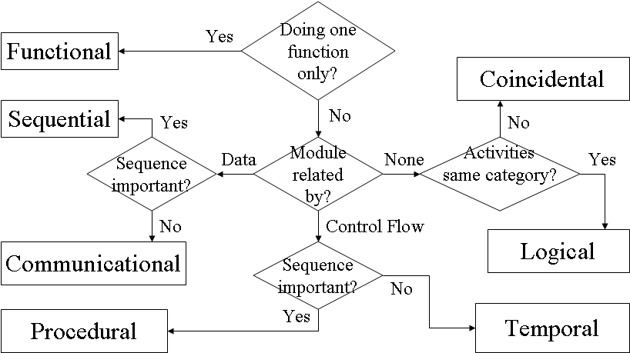

Slide 27
Differentiate between Coupling and Cohesion
Coupling | Cohesion
Coupling is also called Inter-Module Binding. | Cohesion is also called Intra-Module Binding.
Coupling shows the relationships between modules. | Cohesion shows the relationship within the module.
Coupling shows the relative independence between the modules. | Cohesion shows the module's relative functional strength.
While creating, you should aim for low coupling, i.e., dependency among modules should be less. | While creating you should aim for high cohesion, i.e., a cohesive component/ module focuses on a single function (i.e., single-mindedness) with little interaction with other modules of the system.
In coupling, modules are linked to the other modules. | In cohesion, the module focuses on a single thing.

